Slide 1

Project Blink
Proof of Speed - 1.5 Blinkcoin & Hash Rewards

Slide 2
Hash Rewards
In Blinkchain block-rewards are known as Hash Rewards
Instead of fixing a reward per block in native currency, Blinkchain fixes a per hash reward, effectively summarizing more transactions you validate more the reward
This is to avoid empty block mining - as the requirements doesn’t need a specific block size
Hash Rewards = Per hash reward in a sequence with external data
This creates a competition to add maximum hashes in a limited time and limited size. For the producer to win he has to take his requirement to the fullest

Slide 3
Block-reward | Hash-reward
Based on block count | Based on Hash count
Fixed/Predetermined issuance per block | changes in every block
Can have empty blocks | Cannot have empty blocks
Can be altered by governance | Cannot be altered by governance
Rough time-stamps | Accurate time-stamps

Slide 4
Tokenomics

Slide 5
Tokenomics
Pre mined : 5,000,000 Blinkcoins
Max Supply Cap : 7,250,000 Blinkcoins
Inflation Rate : 45% in 9 Yearsa
Avg Inflation Rate (AIR) : 250,000 per year
The Inflation is designed in an inverted parabola curve calculated by set of parameters

Slide 6
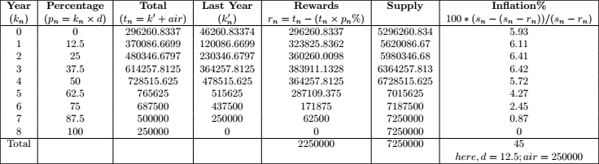

Slide 7
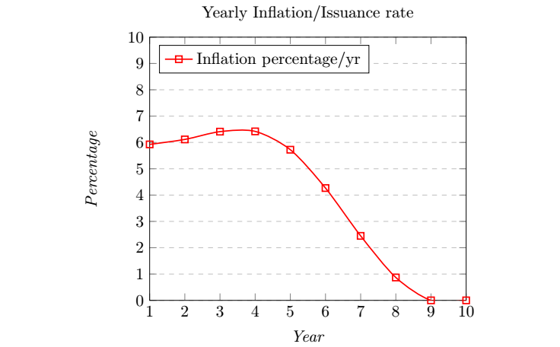

Slide 8
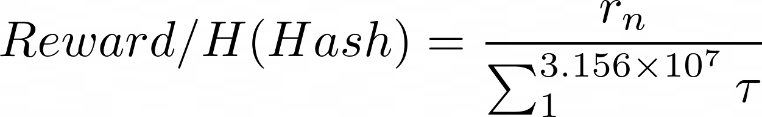
Reward per Hash depend on Legates ?
A year in blockchain equals to the total hashes a legacy hardware can do in 3.154e+7 seconds = 1 year of seconds
From which the each hash reward is fixed by the total annual rewards for the year
Such how a the hash-reward is fixed.

Slide 9
Next : 1.6 Blink Clocks & Validation

